Slide 1
Programming in C

Slide 2
Week 6
Unit Testing

Slide 3

Warm-up
Notes:
How does the video relate to the lesson of today?

Slide 4
Warm-up
Team-up by group of 4 students
Assign a representative
Brainstorm about the following question (max 2 minutes)
How does the video relate to the lesson of today?
Notes:
How does the video relate to the lesson of today?

Slide 5
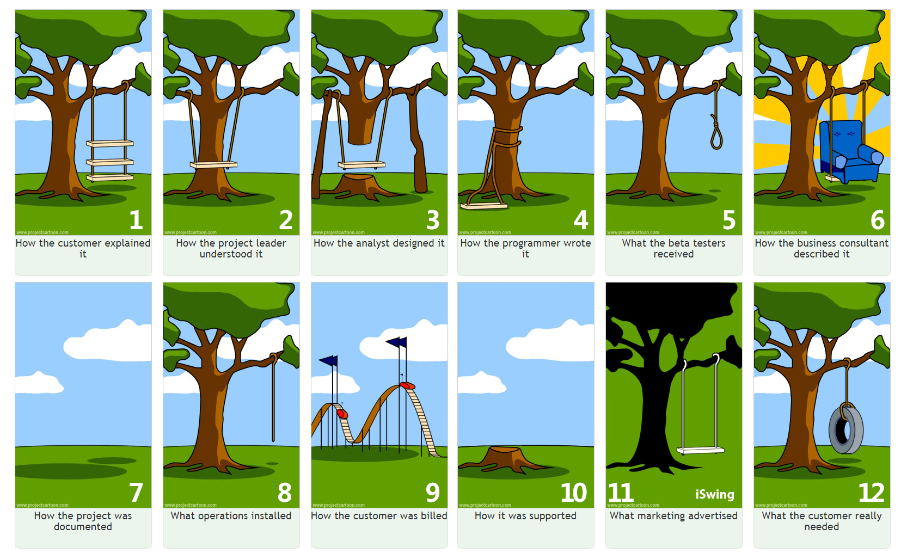
(Embedded) Software Testing
(Embedded) Software testing is a process to ensure that an (end)-user actually gets what he or she requested
What the user asked
What the user shouldn’t get
What the user should get

Slide 6
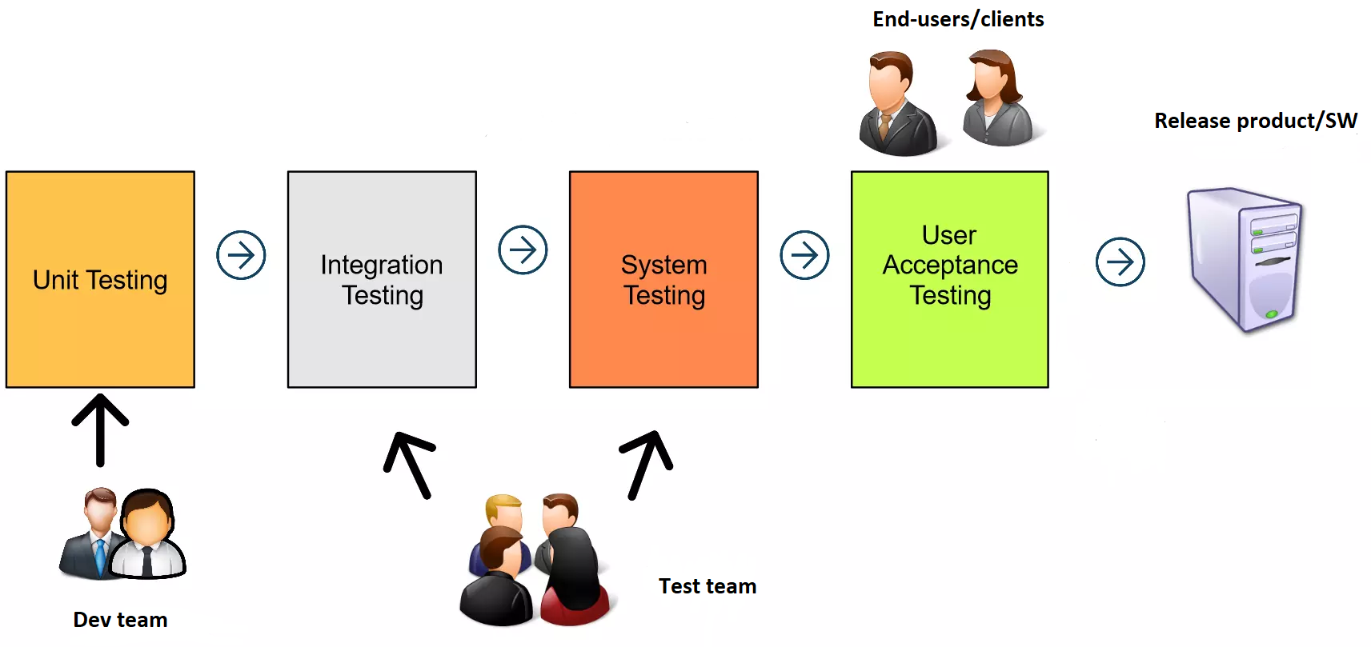
Levels in (Embedded) Software Testing

Slide 7
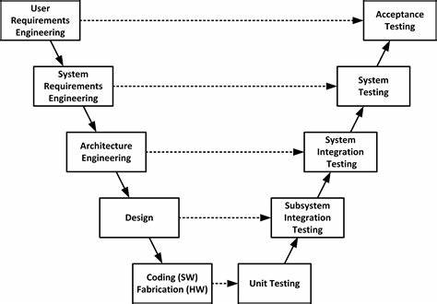
Levels in (Embedded) Software Testing

Slide 8
Levels in (Embedded) Software Testing
Scope of System/Acceptance test
Sensor
Micro-controller
(e.g. esp32)
Actuator
Scope of integration test
UI
(e.g. WinForms)
What is the scope of unit tests?

Slide 9
Levels in (Embedded) Software Testing
Unit
Scope: 1 unit/component
Example: testing a function (e.g. in C) or a method (e.g. in C#)
Integration
Scope: (at least) 2 units/components
Example: testing communication between sensor and μC
System/Acceptance
Scope: all units/components
Example: testing user story or use case

Slide 10
Unit testing Frameworks
Examples of frameworks
Framework | Link(s)/Ressource(s)
Check | https://libcheck.github.io/check/
CTest | https://github.com/bvdberg/ctest
CUnit | https://cunit.sourceforge.net/
Cut | https://github.com/kube/cut
Unity | http://www.throwtheswitch.org/unity https://github.com/ThrowTheSwitch/Unity
We use Unity in T2-CB-PRC
Notes:
GoogleTest User’s Guide | GoogleTest

Slide 11
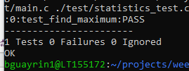
Your Turn! Let's get started with Unity Framework!
Download the ''startup'' project from the git repository:
Workshops/Week6/Wednesday/startUp_UnitTests.zip
Build the program using command make
- In which directory is the executable file created?
- Which command (apart from make run) to run the executable?
Build and execute the unit-test application using make test
- What do you notice in folder startUp_UnitTests/build?
- Check that the following message (or very similar) is printed in your terminal window:
Clean the build using command make clean
- What do you notice in folder startUp_UnitTests/build?
Notes:
GoogleTest User’s Guide | GoogleTest

Slide 12
How to define a test case
Assume that we want to test the following function:
int find_maximum(a, b);
Examples of test cases:
ID | Description | Test inputs/conditions | Expected result
1 | Test function find_maximum when two inputs are positive | First input: 1 Second input: 2 | Function should return 2
2 | Test function find_maximum when two inputs are negative | First input: -1 Second input: -2 | Function should return -1
… | … | … | …

Slide 13
How to write a test case
Unit tests should follow the AAA Principle:
// ARRANGE : Define testing conditions (i.e. inputs of test and expected result(s) )
int a = 1;
int b = 2;
int expected_result = 2;
// ACT : Execute/Call the function (i.e. unit) to be tested
int actual_result = find_maximum(a, b);
// ASSERT : Compare expected and actual results
TEST_ASSERT_EQUAL_INT(expected_result, actual_result);
What is an assertion (aka assert) in SW?

Slide 14
Assertions supported by Unity framework
Examples of assertions. Be investigative and refer to the full list of assertions at:
  http://www.throwtheswitch.org/unity
  https://github.com/ThrowTheSwitch/Unity
Name | (Short) Description
TEST_ASSERT_EQUAL_INT | Asserts that two int variables are equal
TEST_ASSERT_EQUAL_UINT8 | Asserts that two uint8_t variables are equal
TEST_ASSERT_EQUAL_FLOAT | Asserts that two float variables are equal
TEST_ASSERT_EQUAL_INT_ARRAY | Asserts that two arrays of integers are identical
… | …

Slide 15
Defining (exhaustive) test cases
Team-up by group of 4 students
Assign a representative
Brainstorm about the following questions (max 5 minutes)
o What other test cases can be defined to further test function find_maximum?
o When do we know that a function is fully tested?
Notes:
How does the video relate to the lesson of today?

Slide 16
Hints for defining (exhaustive) test cases
Check regular cases:
  E.g. check that a function operates as expected if input parameters are set to value representing a regular/expected use of the function
  Etc.
Check edge/corner cases:
  E.g. check that a function still operates as expected if input parameters are set to either minimum or maximum value
  Etc.
Check all possible execution path, in other words that all lines of code are tested
  E.g. all if and else statements are tested in your function
  Etc.
Check that your function does not manipulate NULL pointers
Do you see more possible test cases?

Slide 17
Hints for defining (exhaustive) test cases
It is the responsibility of the (embedded) software developer to define the needed test cases,
NOT the one of the end-user/client (or teacher) ;)

Slide 18
Exercises
See description and startup code in git (Workshops/Week6/Wednesday/):
Description: exercises_UnitTests.pdf
Startup code: startUp_UnitTests.zip

