Slide 1
Programming in C

Slide 2
Week 4
Pointers

Slide 3
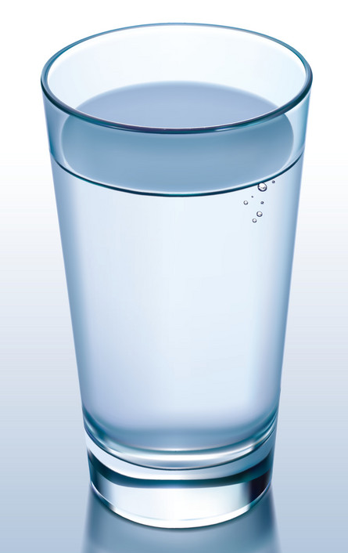
Variable – Definition
A variable can be seen as a container
 | “Real-life” | Programming
Container | Glass | Variable
Content | Water | Value
Location | Position (on table) | Address (in memory)
Notes:
Another way to explain pointers with box and arrow

Slide 4

Pointer – What is it?
A pointer is a variable whose value is the address of another variable, i.e., direct address of the memory location
CPU
Memory
Source:
Kernighan & Ritchie, The C programming language, 1972, Prentice Hall
Notes:
Another way to explain pointers with box and arrow

Slide 5
Pointers - Advantages
Pointers are used i.a. to :
  return (multiple) values from a function (Week 4)
  more efficiently handle arrays (Week 5)
  more efficiently handle structures (Week 5)
  dynamic memory allocation (Semester 3)

Slide 6
Pointers – Basic use
The basic use of pointers involves three steps
Declaration
Initialization
Dereferencing

Slide 7
Pointers – Basic use
Memory
address
Memory
content
…
128
124
120
116
112
108
104
int c;
c
X
5
= 10
// Declaration +
// Initialisation to NULL
int* p = NULL;
p = &c; // Initialization
p
= 124
c = 10;
*p = 5; //dereferencing

Slide 8
Pointers – Basic use
int main()
{
int x = 5;
int *ptr = NULL; // Declaration
ptr = &x; // Initialization
*ptr = 8; // Dereferencing
printf("x = %d\n", x);
printf("Address of x = %p\n", (void*) ptr);
return 0;
}
int main()
{
int x;
scanf(“%d”, &x); // scanf uses pointers
printf(" x = %d\n", x);
printf(" Address of x = %p\n", (void*) &x);
return 0;
}
What value of x is printed to the terminal? Why?

Slide 9
Pointers - Use with functions
There are i.a. two options to use pointers with functions, namely option1 and option2 (see next slides)
It is the responsability of the developer to choose one of the options
The two options simply differ in the coding style used to handle NULL pointers

Slide 10
Pointers - Use with functions (Option1)
What will be printed to the terminal?
// Without using pointers
int add_v1(int a, int b)
{
int result = a + b;
return result;
}
int main()
{
int x = 2;
int y = 3;
int z = 0; // Result (x+y)
int* ptr_z = NULL; // Pointer to result
// Make sure NOT to use NULL pointers
if (ptr_z == NULL) {
printf(“FAILED : Invalid pointer”);
return 0;
}
add_v2(x,y, ptr_z);
printf(“Result : %d\n”, *ptr_z);
return 0;
}
// With using pointers
void add_v2(int a, int b, int* result)
{
*result = a + b; // Dereferencing
}
What difference(s) do you see between add_v1 and add_v2?
Notes:
Return pointers

Slide 11
Pointers - Use with functions (Option2)
How/when can it happen that a pointer is invalid?
bool add(int a, int b, int* result)
{
// Don’t use pointers if not initialised
// with a valid memory address
if (result == NULL) {
return false;
}
*result = a + b; // Dereferencing
return true;
}
int main()
{
int x = 2;
int y = 3;
int z;
bool success = add (a,b, &z);
if (success==TRUE) {
printf(“Result : %d\n”, z);
}
else {
printf(“FAILED _: Invalid pointer”);
}
return 0;
}
You may also use e.g. an int instead of a bool
Notes:
Return pointers

Slide 12

Pointers - Demo
See also in git (Workshops/Week4): demoPointers.zip

Slide 13
Pointers - Exercise 1
You can do it without ChatGPT!
Add the code to print the value and address of variables x and y. Keep y uninitialized.
Build the code. Tip: remove temporarily –Werror from the Makefile. This will allow (for this exercise) not to treat warnings as errors
Execute the code and analyse the results. What do you notice? Can you explain?
#include <stdio.h>
void f1(int xval)
{
int x;
x = xval;
// Print here the address and value of x
}
void f2()
{
int y;
// print here the address and value of y
}
int main()
{
f1(7);
f2();
return 0;
}
Notes:
Give the prototype of the function

Slide 14
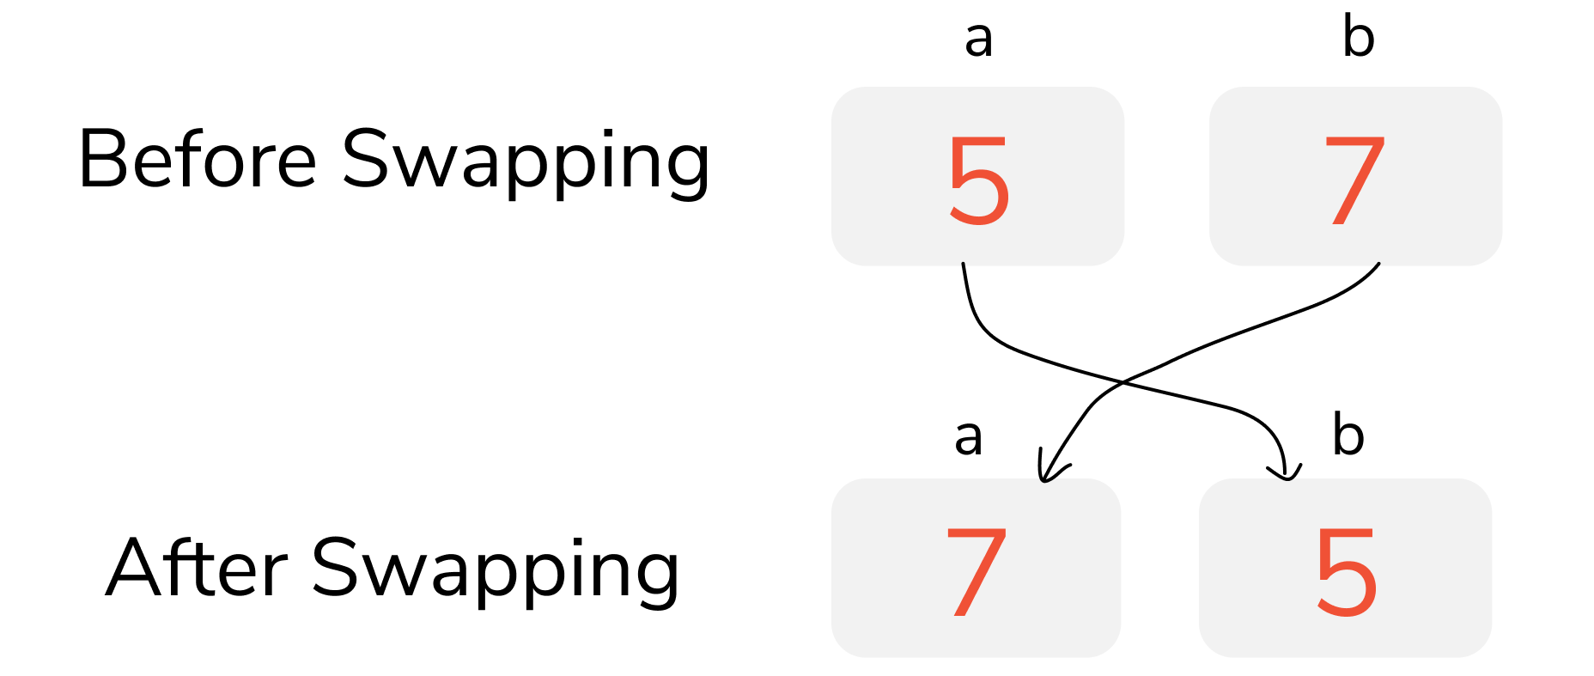
Pointers - Exercise 2
You can do it without ChatGPT!
Write a function to swap the value of two variables using pointers. Possible prototype: void swap(int* a, int* b);
Notes:
Give the prototype of the function

Slide 15
Pointers - Exercise 3
You can do it without ChatGPT!
Write a function to sort 3 numbers in ascending order by using pointers. Possible prototype: void sort3(int* x, int* y, int* z);
 | x | y | z
Before sorting | 22 | 15 | 18
After sorting | 15 | 18 | 22
Notes:
Give the prototype of the function

