Slide 1
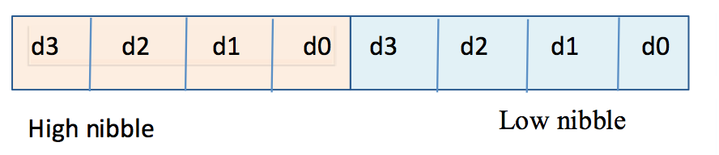
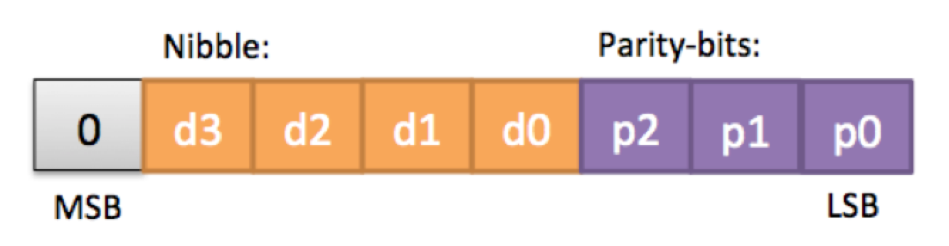
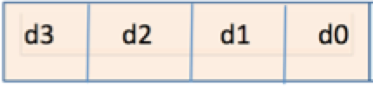
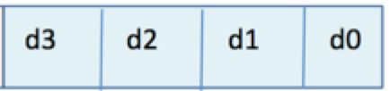

Slide 2
Adidas module design
encode_main.c
decode_main.c
channel_main.c
encode.c
decode.c
io.c
channel.c
io.c
parity.c
io.c
parity.c
encode
channel
decode

Slide 3
Nibble:
Parity-bits:
0
d3
d2
d1
d0
p2
p1
p0
MSB
LSB

