Slide 1
Programming in C

Slide 2
Week 9
Bit manipulation: Application

Slide 3
Recap of previous week
Complete the table below to recap data units. Tips:
  # means Number of
  Consider unsigned data-types only
Data units (CPU) | # bits | datatype(s) (C) | Min. Value (decimal) | Max. Value (decimal)
Byte
Word
Nibble
Long word

Slide 4
Recap of previous week
Complete the table below to recap conversion of numeral systems. Tip: first manually convert from BIN to DEC, then manually convert from DEC to HEX. Avoid using your calculator!
Binary (base2) | Decimal (base10) | Hexadecimal (base16)
0010
1000
1010
1011

Slide 5
Why bit manipulation?
Using bit manipulation on registers, you can control uC features such as:
  The GPIO to handle IO’s (e.g. read status of BTN, update status of LED, etc)
  PWM to e.g. drive motors
  I2C to e.g. communicate with external devices
  Etc
uC: micro-controller
GPIO: General Purpose Input Output
PWM: Pulse-Width Modulation
I2C: Inter-Integrated Communication (invented by Philips in 1982)

Slide 6
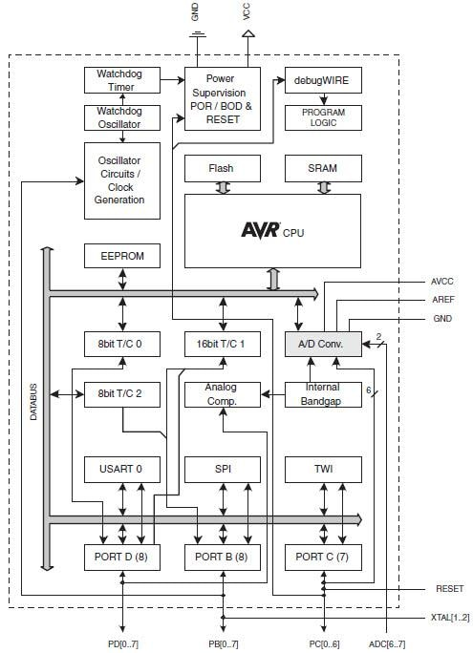
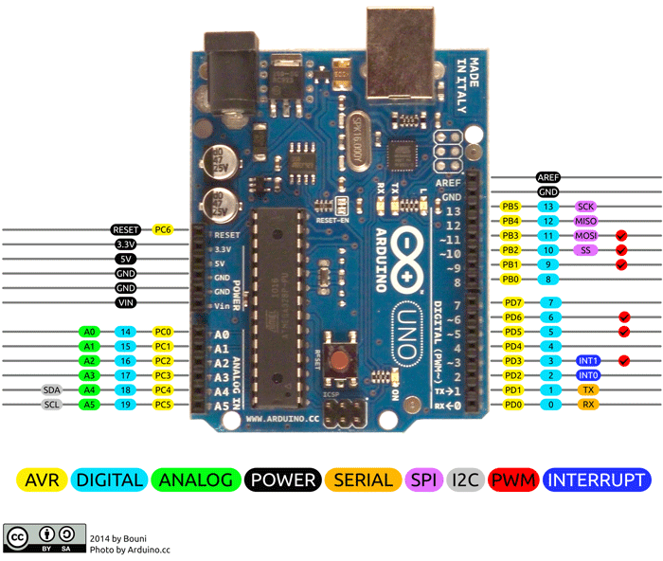
Why bit manipulation?
I/O pins are grouped in bytes (i.e. 8 bits)

Slide 7
Why bit manipulation?
Register = group of bytes (e.g. 8-bit, 16-bit, 32-bit, etc)
Registers are usually memory-mapped (e.g. in Arduino platform):
Address | Memory
0x20 | Register1
0x21 | Register2
0x22 | Register3
….. | …..

Slide 8
Why bit manipulation?
PD0
READ 0/1
(LOW/HIGH)
On Arduino, we use an 8-bit register to control PORTD pins.
Each bit of the register control a different pin
PD1
BTN
PD2
RELEASED/
PRESSED
PD3
PD4
PD5
Write 0/1
(LOW/HIGH)
PD6
LED
PD7
OFF/ON
PORTD
pins
IO’s

Slide 9
Bit manipulation in Embedded Systems:
Mask (a.k.a. bitmask)
Team-up with a classmate
Perform the following bit manipulation: out = in OR mask
Answer the questions below
Q1: Compare out with in. What do you notice?
Q2: What do you think is the purpose of the mask?
 | b7 | b6 | b5 | b4 | b3 | b2 | b1 | b0
in | 1 | 0 | 1 | 0 | 1 | 0 | 1 | 0
mask | 0 | 0 | 0 | 1 | 0 | 0 | 0 | 0
out

Slide 10
Bit manipulation in Embedded Systems:
Mask (a.k.a. bitmask)
Tam-up with a classmate
Perform the following bit manipulation: out = in AND mask
Answer the questions below
Q1: Compare out with in. What do you notice?
Q2: Compare the mask with the one of the previous exercise (see previous slide).
What do you notice?
 | b7 | b6 | b5 | b4 | b3 | b2 | b1 | b0
in | 1 | 0 | 1 | 0 | 1 | 0 | 1 | 0
mask | 1 | 1 | 0 | 1 | 1 | 1 | 1 | 1
out

Slide 11
Bit manipulation in Embedded Systems:
4 generic use cases
Setting bits to 1
  Examples: turning LEDs On, Force bits of a register to 1
Setting bits to 0
  A.k.a. clearing bits
  Examples: turn LEDs Off, Force bits of a register to 0
00111011
11100000
input data
|
input mask
!!!MASK SHOULD BE INVERTED!!!
11111011
output data
See demo in git (Workshops/Week9):
demoBitManipulationApplied.zip
11101011
11110001
input data
&
input mask (inverted)
11100001
output data

Slide 12
Bit manipulation in Embedded Systems:
4 generic use cases
Reading bits
  Examples: read state of BTNs, read bits of a register
Toggling bits
  Examples: toggle LEDs,
  toggle bits of a register
11101011
01110000
input data
00111001
00001110
input data
&
input mask
^
input mask
01100000
output data
00110111
output data
00110111
00001110
^
input mask
00111001
output data

Slide 13
Exercise 1 : Creating a mask
Step1: Create an unsigned 8-bit integer variable named mask. Initialize mask decimal value 1
Step2: Print the result in binary format to the terminal
Step3: Shift mask by 4 bit position to the left. Which bit-wise operator will you use?
Step4: Display the result in binary to the terminal. What value to you expect? Visually compare the binary values of mask before and after shifting.

Slide 14
Exercise 2 : Setting a bit
Step1: Create an unsigned 8-bit integer initialized with binary value 1101 1010 (b7 b6 b5 b4 b3 b2 b1 b0)
Step2: Print the result in binary (or hexa) format to the terminal
Step3: Set the third bit (b2) to 1 of the 8-bit integer using bitwise operators. Do not forget to create a mask (see exercise1). Which bit-wise operator will you use to set the bit?
Step4: Display the result to the terminal in binary (or hexa) format. What value do you expect?

Slide 15
Exercise 3 : Clearing and toggling a bit
Repeat exercise 2 but replace step3 with following bit manipulation:
  Clear the second bit (b1). Tips:
    do not forget to invert the mask when clearing a bit
    'Clear' means 'set to 0'
Repeat exercise 2 but replace step3 with following bit manipulation:
  Toggle the seventh bit (b6).

Slide 16
Exercise 4: manipulate a register
Pre-requisite: study the specific use case described in following slides.
We consider an 8-bit register named config:
We want to set bits b4, b3, b2, b1 of config to 0b1001. So, after bit manipulation, the modified register config will be:
Implement a C program to update register config, following the process described in the following slides.
 | b7 | b6 | b5 | b4 | b3 | b2 | b1 | b0
config | 0 | 1 | 1 | 0 | 1 | 0 | 0 | 1
 | b7 | b6 | b5 | b4 | b3 | b2 | b1 | b0
config | 0 | 1 | 1 | 1 | 0 | 0 | 1 | 1

Slide 17
Bit manipulation in Embedded Systems:
Specific use case (exercise4, Watch challenge)
Use-case definition:
  We consider an 8-bit register named config:
  We want to set bits b6, b5 and b4 of config to 0b100. So, after bit manipulation, the modified register config will be:
 | b7 | b6 | b5 | b4 | b3 | b2 | b1 | b0
config | 1 | 0 | 1 | 0 | 1 | 0 | 1 | 1
 | b7 | b6 | b5 | b4 | b3 | b2 | b1 | b0
config | 1 | 1 | 0 | 0 | 1 | 0 | 1 | 1

Slide 18
Bit manipulation in Embedded Systems:
Specific use case (exercise4, Watch challenge)
Process to solve use-case:
  STEP1 (first step): We consider an 8-bit register named config:
  STEP2: We define an 8-bit integer mask to manipulate b6, b5, b4:
 | b7 | b6 | b5 | b4 | b3 | b2 | b1 | b0
config | 1 | 0 | 1 | 0 | 1 | 0 | 1 | 1
 | b7 | b6 | b5 | b4 | b3 | b2 | b1 | b0
mask | 0 | 1 | 1 | 1 | 0 | 0 | 0 | 0

Slide 19
Bit manipulation in Embedded Systems:
Specific use case (exercise4, Watch challenge)
Process to solve use-case:
  STEP3: We apply mask to register config using bit-wise operator AND. We do this to clear b6, b5 and b4 Note: the mask is inverted!
 | b7 | b6 | b5 | b4 | b3 | b2 | b1 | b0
config | 1 | 0 | 1 | 0 | 1 | 0 | 1 | 1
inverted_mask | 1 | 0 | 0 | 0 | 1 | 1 | 1 | 1
cleared_config | 1 | 0 | 0 | 0 | 1 | 0 | 1 | 1
cleared_config = config AND inverted_mask

Slide 20
Bit manipulation in Embedded Systems:
Specific use case (exercise4, Watch challenge)
Process to solve use-case:
  STEP4: We initialise a new 8-bit integer to 0b100:
  STEP5: We properly shift the new 8-bit integer to match the position of b6, b5 and b4:
 | b7 | b6 | b5 | b4 | b3 | b2 | b1 | b0
new_value | 0 | 0 | 0 | 0 | 0 | 1 | 0 | 0
 | b7 | b6 | b5 | b4 | b3 | b2 | b1 | b0
shifted_new_value | 0 | 1 | 0 | 0 | 0 | 0 | 0 | 0

Slide 21
Bit manipulation in Embedded Systems:
Specific use case (exercise4, Watch challenge)
Process to solve use-case:
  STEP6 (final step): We set b6, b5, b4 of register config to 0b100 by using bit-wise operator OR:
 | b7 | b6 | b5 | b4 | b3 | b2 | b1 | b0
cleared_config | 1 | 0 | 0 | 0 | 1 | 0 | 1 | 1
shifted_new_value | 0 | 1 | 0 | 0 | 0 | 0 | 0 | 0
new_config | 1 | 1 | 0 | 0 | 1 | 0 | 1 | 1
new_config = cleared_config OR shifted_new_value

Slide 22
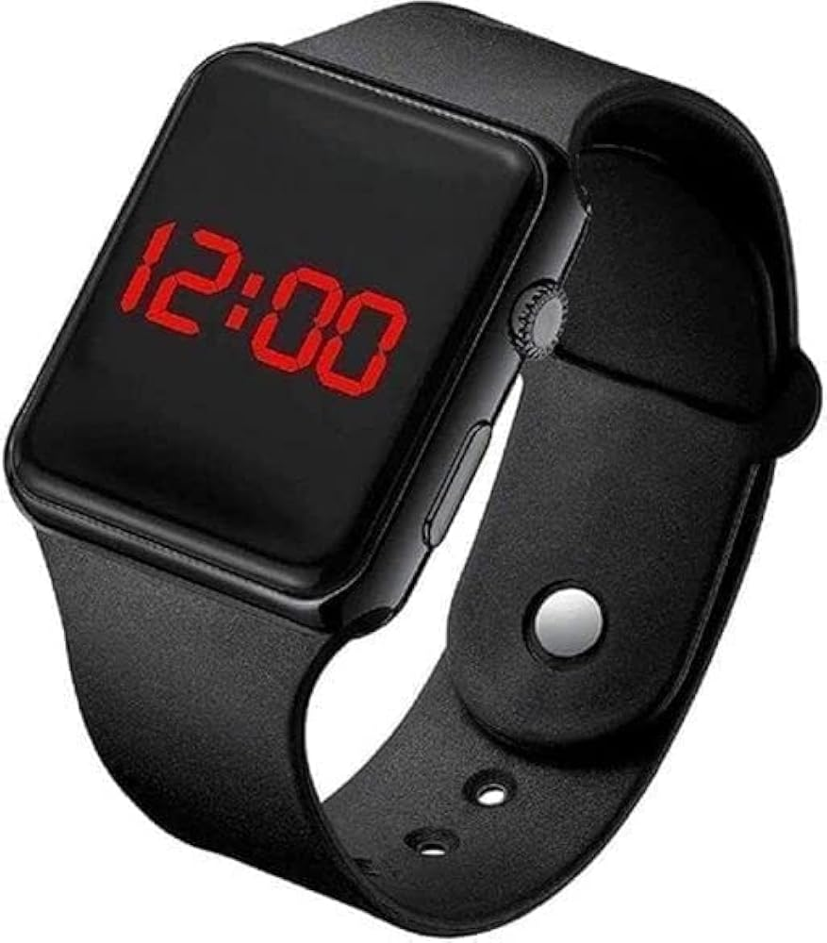
Done with exercises?
Work on the Watch challenge!

