Slide 1
Programming in C

Slide 2
Week 8
Bit manipulation: Basics

Slide 3
Numeral systems
Decimal (base 10) | Binary (Base 2) | Hexa-decimal (base 16)
0 | 0000 0000 | 00
1 | 0000 0001 | 01
2 | 0000 0010 | 02
… | … | …
9 | 0000 1001 | 09
10 | 0000 1010 | 0A
… | … | …
15 | 0000 1111 | 0F
16 | 0001 0000 | 10
255 | 1111 1111 | FF

Slide 4
Numeral systems
Find the binary and hexa-decimal equivalent of decimal 3, 4, 11 and 12:
Decimal (base 10) | Binary (Base 2) | Hexa-decimal (base 16)
0 | 0000 0000 | 00
1 | 0000 0001 | 01
2 | 0000 0010 | 02
3 | ? | ?
4 | ? | ?
… | … | …
9 | 0000 1001 | 09
10 | 0000 1010 | 0A
11 | ? | ?
12 | ? | ?

Slide 5
Numeral systems
Conversion from binary to decimal:
b7 | b6 | b5 | b4 | b3 | b2 | b1 | b0
1 | 0 | 1 | 0 | 1 | 0 | 1 | 0
(10101010)₂ = 1x2⁷ + 0x2⁶ + 1x2⁵ + 0x2⁴ + 1x2³ + 0x2² + 1x2¹ + 0x2⁰
(10101010)₂ = 1x128 + 0x64 + 1x32 + 0x16 + 1x8 + 0x4 + 1x2 + 0x1
(10101010)₂ = (170)₁₀
base 2 (binary)
base 10 (decimal)

Slide 6
Data units (in CPU)
# bits values Unit name CPU unit
1 bit 2 bit 1 byte
4 bits 16 nibble 1 byte 8 bits 256 byte 1 byte
16 bits 65 536 word 2 bytes
32 bits 4 294 967 296 long word 4 bytes
64 bits 18 446 744 073 709 551 616 very long word 8 bytes
With 1 bits you can represent 2 values!
With 4 bits you can represent 16 values!
With 8 bits you can represent 256 values!
With N bits you can represent 2^{N} values!

Slide 7
Data types (in C)
Download the demo project from the got repository: Workshops/Week8/demoBitManipulationBasics.zip
Team-up with a classmate and answer the following questions
Q1: What does uint8_t and int8_t mean?
Q2: What does 0b and 0x mean when initialising a variable?
Q3: Initialise variable var_1 to 256 (in decimal format). Build and execute the program. What do you notice? What datatype would you use to properly initialise var_1 to 256?
Q4: What min and max values can be represented using datatypes uint8_t and int8_t?
Q5: What format specifier to use to print values in decimal and hexa-decimal format? Is there a format specifier (in C language) to print values in binary formal?

Slide 8
Data types (in C)
In C you can use the decimal, binary and hexa-decimal systems when initializing a variable:
  uint8_t varA = 11; // Decimal
  uint8_t varB = 0b00001011; // Binary
  uint8_t varC = 0x0B // Hexa-decimal

Slide 9
Data types (in C)
Difference between signed and unsigned integers:
 | uint8_t | int8_t
Definition | 8-bit unsigned integer | 8-bit signed integer
Practical use | To represent positive only numbers | To represent positive and negative numbers
Range | between 0 and (2⁸-1) | between (-2⁷) and (2⁷-1)

Slide 10
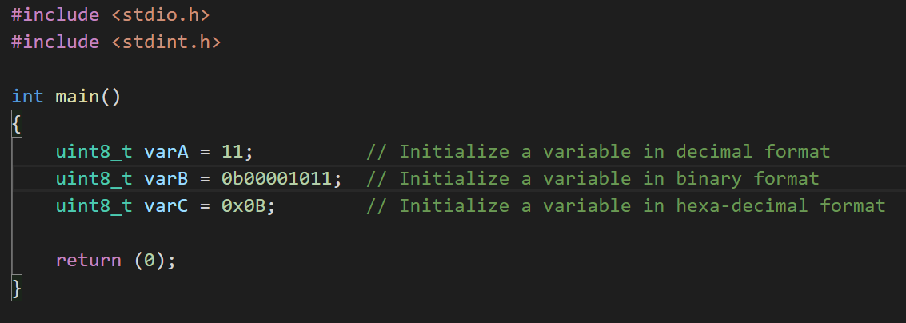
Data types (in C)

Slide 11
Data types (in C)
The C language provides specifier for printing values in decimal and hexa-decimal format. There’s no specifier in C for printing in binary format. Tip: to print in binary, you may use the helper function provided in archive demoBitManipulationBasics.zip in canvas.
Format specifier | Description
%d | Print a decimal integer value
%x | Print a hexadecimal integer value starting with prefix 0x. The hexadecimal value is printed using lower case
%X | Print a hexadecimal integer value starting with prefix 0x. The hexadecimal value is printed using upper case

Slide 12
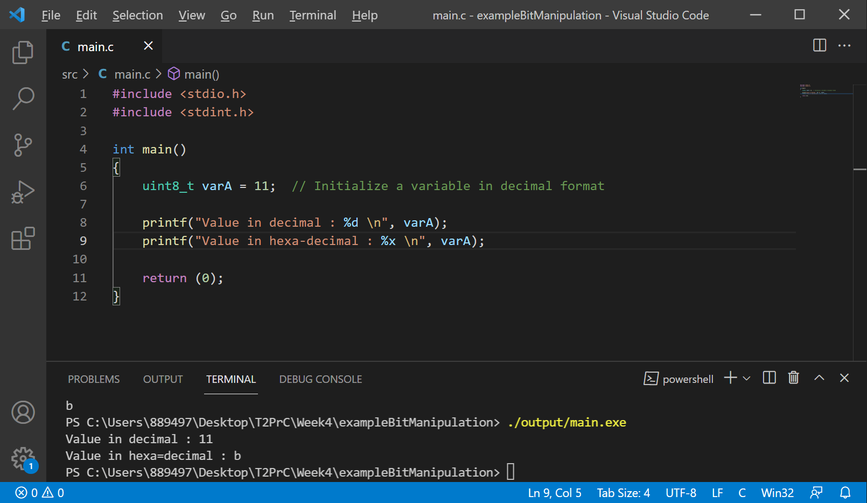
Data types (in C)

Slide 13
Bitwise operators
c = a & b; //bitwise AND
c = a | b; //bitwise OR
c = a ^ b; //bitwise XOR
c = ~a; //bitwise NOT
b = b >> n; //shift n bits to the right
b = b << n; //shift n bits to the left
Truth Table
a | b | a&b | a I b | a ^ b | ~a
0 | 0 | 0 | 0 | 0 | 1
0 | 1 | 0 | 1 | 1 | 1
1 | 0 | 0 | 1 | 1 | 0
1 | 1 | 1 | 1 | 0 | 0

Slide 14
Bitwise operators
uint8_t A = 0b00111011; // 0x3B
uint8_t B = 0b10010110; // 0x96
 | b7 | b6 | b5 | b4 | b3 | b2 | b1 | b0
A | 0 | 0 | 1 | 1 | 1 | 0 | 1 | 1
B | 1 | 0 | 0 | 1 | 0 | 1 | 1 | 0
A&B | 0 | 0 | 0 | 1 | 0 | 0 | 1 | 0
A|B | 1 | 0 | 1 | 1 | 1 | 1 | 1 | 1
A^B | 1 | 0 | 1 | 0 | 1 | 1 | 0 | 1

Slide 15
Bitwise operators
uint8_t A = 0b00111011; // 0x3B
uint8_t B = 0b10010110; // 0x96
 | b7 | b6 | b5 | b4 | b3 | b2 | b1 | b0
A | 0 | 0 | 1 | 1 | 1 | 0 | 1 | 1
~A | 1 | 1 | 0 | 0 | 0 | 1 | 0 | 0
B | 1 | 0 | 0 | 1 | 0 | 1 | 1 | 0
~B | 0 | 1 | 1 | 0 | 1 | 0 | 0 | 1

Slide 16
Bitwise operators
uint8_t A = 0b00111011; // 0x3B
uint8_t B = 0b10010110; // 0x96
 | b7 | b6 | b5 | b4 | b3 | b2 | b1 | b0
A | 0 | 0 | 1 | 1 | 1 | 0 | 1 | 1
A>>1 | 0 | 0 | 0 | 1 | 1 | 1 | 0 | 1
B | 1 | 0 | 0 | 1 | 0 | 1 | 1 | 0
B<<4 | 0 | 1 | 1 | 0 | 0 | 0 | 0 | 0

Slide 17
Exercise 1-a : bitwise operators
Manually calculate the result of the following operations
Bitwise operations | Result (binary) | Result (hexa-decimal)
1011 0010 AND 0011 0101
1011 0010 OR 0011 0101
1011 0010 XOR 0011 0101
NOT 1010 0110

Slide 18
Exercise 1-b : bitwise operators
Manually calculate the result of the following operations
Bitwise operations | Result (binary) | Result (hexa-decimal)
0001 1000 >> 1
0001 1000 >> 2
0001 1000 >> 5
0001 1000 << 3

Slide 19
Exercise 2 : bitwise operators
Implement a C program performing the bitwise operations of exercises 1-a and 1-b
  Which datatype will you use?
Display the result of the bitwise operations to the terminal
  In which format (e.g. decimal, binary, hexa-decimal) will you print the results?
  Are the values in the terminal matching the results from previous exercise?

Slide 20
Exercise 3 : datatypes
Fill in the following table to review the difference between datatypes commonly used to manipulate bits
 | uint8 | int8 | uint16 | int16
Minimum value
Maximum value
Number of values

Slide 21
Exercise 4 : decoding
The secret services have intercepted a 16-bit binary message corresponding to the 4-digit passcode of a safe. Each nibble represents one decimal digit (from 0 to 9) of the passcode:
16-bit binary message | 0 1 1 0 (b15 b14 b13 b12) | 0 1 0 0 (b11 b10 b9 b8) | 1 0 0 1 (b7 b6 b5 b4) | 0 1 1 0 (b3 b2 b1 b0)
4-digit decimal passcode | 0-9 (D1: 1st digit) | 0-9 (D2: 2nd digit) | 0-9 (D3: 3rd digit) | 0-9 (D4: 4th digit)

Slide 22
Exercise 4 : decoding
Implement a function/algorithm to decode the 16-bit message into an array array_passcode containing the 4 digits of the passcode.
// Returns 0 on success or -1 if an error occurs int decode_message(uint16_t binary_message, int* array_passcode, size_t number_of_digits)
array_passcode[0] | array_passcode[1] | array_passcode[2] | Array_passcode[3]
1st decimal digit (D1) | 2nd decimal digit (D2) | 3rd decimal digit (D3) | 4th decimal digit (D4)
Implement unit tests to verify the correctness of your implementation

