Slide 1
Programming in C

Slide 2
Week 5
Pointers and Arrays

Slide 3

Pointers - Recap
int c;
int *p; /* declare a pointer */
p = &c; /* assign the address of c to p */
*p = 5; /* dereferencing the pointer p */

Slide 4
Debugging challenge (self-study)
Download starting code in git (Workshops/Week5) :
debuggingChallenge.zip
Perform the challenge as described in the starting code. The challenge will help you to practice pointers
Will you be able to solve all complier errors and bugs in the starting code?

Slide 5

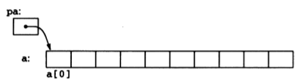
Pointers and Arrays - Basics
int a[10];
int *pa;
pa = &a[0];

Slide 6
Pointers and Arrays – Basics
Execute and analyse the following code:
  What values are printed? Why?
  What is the difference between the addresses of a[0] and a[1]? Why?
Extend the code to print the value and address of a[3]
int a[5] = {2, 4, 5, 8, 1};
int* p_a = &a[0];
printf("a[0]: %d\n", a[0]);
printf("*p_a : %d\n", *p_a);
printf("*a : %d\n", *a);
printf("a[1]: %d\n", a[1]);
printf("*(p_a+1) : %d\n", *(p_a+1));
printf("*(a+1) : %d\n", *(a+1));
int a[5] = {2, 4, 5, 8, 1};
int* p_a = &a[0];
printf("&a[0]: %p\n", (void*) &a[0]);
printf("p_a : %p\n", (void*) p_a);
printf("a : %p\n", (void*) a);
printf("&a[1]: %p\n", (void*) &a[1]);
printf("p_a+1 : %p\n", (void*) (p_a+1));
printf("a+1 : %p\n", (void*) (a+1));

Slide 7
Pointers and Arrays - Basics
int a[5] = {2, 4, 5, 8, 1};
int *pa = a; // same as : int *pa = &a[0];
int x = *pa; // same as : int x = a[0];
MEMORY | ADDRESS | pa | pa+1 | pa+2 | pa+3 | pa+4
 |  | &a[0] | &a[1] | &a[2] | &a[3] | &a[4]
 |  | 200 | 204 | 208 | 212 | 216
 | VALUE | 2 | 4 | 5 | 8 | 1
 |  | a[0] | a[1] | a[2] | a[3] | a[4]
 |  | *pa | *(pa+1) | *(pa+2) | *(pa+3) | *(pa+4)
Pointer arithmetic
Array indexing
Array indexing
Pointer arithmetic

Slide 8
Pointers and Arrays – Self-study Quiz
Given:
  int a[6] = { 3, 6, -3, 1, 8, 3 };
  int i = 3, j = 8;
  int* p = a;
  int* q;
  int* r = &a[1];
Find the result of the following operations:
  i = *(p + 5);
  j = sizeof (a);
  r[2] = p[2] + a[1];
  *q += (*p )* (*r);
Operation | Result
i = *(p+5)
j = sizeof(a)
r[2] = p[2] + a[1]
*q += (*p)*(*r)
i = 3
j = 24
r[2] = 3
*q does not point to any data

Slide 9
Pointers and arrays – Array indexing Vs Pointer arithmetic
#define SIZE_ARRAY 5
int sumOfElements(int a[ ], int size)
{
int sum = 0;
for (int i = 0; i < size; i++)
{
sum += a[i];
}
return sum;
}
int main()
{
int a[] = {1,2,3,4,5};
int sum = sumOfElements(a, SIZE_ARRAY);
printf(“Sum of elements is %d\n”, sum);
}
#define SIZE_ARRAY 5
int sumOfElements(int *a, int size)
{
int sum = 0;
for (int i = 0; i < size; i++)
{
sum += *(a+i);
}
return sum;
}
int main()
{
int a[] = {1,2,3,4,5};
int sum = sumOfElements(a, SIZE_ARRAY);
printf(“Sum of elements is %d\n”, sum);
}
Array indexing
Pointer arithmetic
What differences do you see between the 2 versions?

Slide 10
Pointers and arrays – Optimized pointer arithmetic
#define SIZE_ARRAY 5
int sumOfElements(int *a, int size)
{
int sum = 0;
for (int i = 0; i < size; i++)
{
sum += *(a+i);
}
return sum;
}
int main()
{
int a[] = {1,2,3,4,5};
int sum = sumOfElements(a, SIZE_ARRAY);
printf(“Sum of elements is %d\n”, sum);
}
#define SIZE_ARRAY 5
int sumOfElements(int *a, int size)
{
int sum = 0;
for (int i = 0; i < size; i++)
{
sum += *a;
a++;
}
return sum;
}
int main()
{
int a[] = {1,2,3,4,5};
int sum = sumOfElements(a, SIZE_ARRAY);
printf(“Sum of elements is %d\n”, sum);
}
Pointer arithmetic
(not optimized)
Pointer arithmetic
(optimized)
Why the version on the right is more optimised?

Slide 11
Exercise 1
You can do it without tools such as ChatGPT!
Function name | count_value
Description | The function counts the occurrence of a specified value in an array
Possible prototype | bool count_value(int* array, int size_array, int value, int* count)
Tips | Ensure that you do not process invalid pointers. Remember that there are two ways to do so (refer to lesson of Week4) You may use pointer arithmetic or array indexing. Whichever your choice, make sure to be able to motivate your choice

Slide 12
Exercise 2
You can do it without tools such as ChatGPT!
Function name | search_value
Description | The function checks if an array contains a specified value.
Possible prototype | bool search_value(int* array, int size_array, int value, bool* result)
Tips | Will you need to (always) iterate trough all elements of the array? Think of optimising your search whenever possible

Slide 13
Exercise 3
You can do it without tools such as ChatGPT!
Function name | reverse_order
Description | The function reverses the order of elements in an array.
Possible prototype | bool reverse_order(int* array, int size_array)
Tips | Think of taking advantage of modularity. Will you re-use the swap function of lesson of week5?

Slide 14
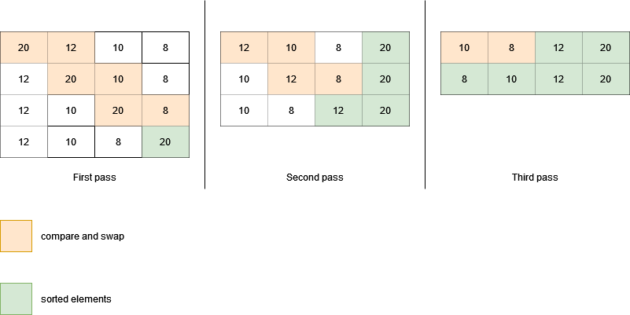
Sorting arrays: “bubble sort” algorithm
(Self-study)
How many “compare and swap” needed to sort an array? Does it depend on the size of the array?
How many “for loop” needed to sort an array? Does it depend on the size of the array?

Slide 15
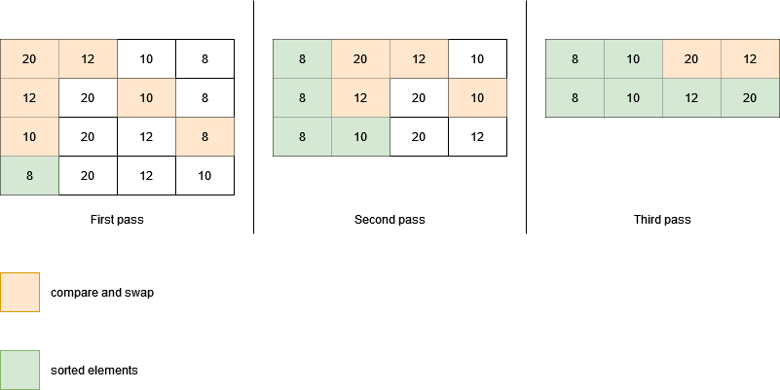
Sorting arrays: “exchange sort” algorithm
(Self-study)

Slide 16
Exercise 4
You can do it without tools such as ChatGPT!
Function name | bubble_sort
Description | The function sorts an array using the bubble sort algorithm.
Possible prototype | bool bubble_sort(int* array, int size_array)

Slide 17
Exercise 5
You can do it without tools such as ChatGPT!
Function name | exchange_sort
Description | The function sorts an array using the exchange sort algorithm.
Possible prototype | bool exchange_sort(int* array, int size_array)

