Slide 1
Programming in C

Slide 2
Week 2
Headers & Modules
Build process

Slide 3
Warm-up challenge
Team-up with a classmate
Download starting project from git (Workshops/Week2):
startUpProject.zip
Perform the (simple) challenge as described in main.c. The expected time to complete the challenge is 15 minutes
Note that we will use this challenge to introduce Headers and Modules

Slide 4
Modular approach for large program
Reusability: Separate large file into smaller modules or libraries, which can be shared amongst many programs
Maintainability: Each module can be compiled separately, and can be linked in compile time
Unix utilities such as make help us to maintain large system
Notes:
Every module has well defined interface serves other modules.
Every module has the implementation part that other modules should not care about.

Slide 5
Modular approach for large program
Function modules
Data modules
Interface vs. implementation

Slide 6
Modular approach for large program
Program_name.c
Program_name
Module1.h
Module2.h
Module1.o
Module2.o
Module1.c
Module2.c
Notes:
Modularization has several benefits, especially on large and complex programs:
1. modules can be re-used in several projects;
2. changing the implementation details of a modules does not require to modify the clients using them as far as the interface does not change;
3. faster re-compilation, as only the modules that have been modified are actually re-compiled;
4. self-documenting, as the interface specifies all that we need to know to use the module;
easier debugging, as modules dependencies are clearly specified and every module can be tested separately

Slide 7
.c and .h files
playlist.h:
#ifndef PLAYLIST_H
#define PLAYLIST_H
int getNrOfSongs(void);
... // other prototypes
#endif
main.c:
#include "playlist.h"
int main(void)
{
int n;
n = getNrOfSongs();
...
}
playlist.c:
#include "playlist.h"
int getNrOfSongs(void)
{
// implementation
}
// other function

Slide 8
Header file
Declarations that can be shared to other programs are put in a header file with .h suffix
Header files only contain declarations of data type, function prototypes and pre-processor directives
  Data type: typedef, enum
  Function prototype
  Pre-processor directives (e.g. #define)
Other programs use the module by including the header file
  #include “my_header.h”
  #include <stdio.h> /*standard library */

Slide 9
Once-only headers
If a header file happens to be included twice, the compiler will process its contents twice and it may result in an error. The standard way to prevent multiple inclusion is to:
#ifndef HEADER_FILE
#define HEADER_FILE
the entire header file
#endif
Notes:
If a header file happens to be included twice, the compiler will process its contents twice and it will result in an error. The standard way to prevent this is to enclose the entire real contents of the file in a conditional, like this

Slide 10
Exercise : creating Headers & Modules
Refactor the Warm-Up challenge using Headers & Modules
Are you able to build succesfully? To do so we need to understand the build process and (possibly) to update the makefile
Demo & solution available in git (Workshops/Week2): demoWeek2.zip

Slide 11
Build process - overview
Human-readable code
Machine-readable code
source code
(.h and .c files)
Preprocessor
Compiler
Assembler
Linker
executable
(.exe or .hex file)
code
(.c files)
code
(.a files)
code
(.o files)
Notes:
The C Preprocessor is not a part of the compiler, but is a separate step in the compilation process. In simple terms, a C Preprocessor is just a text substitution tool and it instructs the compiler to do required pre-processing before the actual compilation. We'll refer to the C Preprocessor as CPP.
All preprocessor commands begin with a hash symbol (#). It must be the first nonblank character, and for readability, a preprocessor directive should begin in the first column. The following section lists down all the important preprocessor directives −

Slide 12
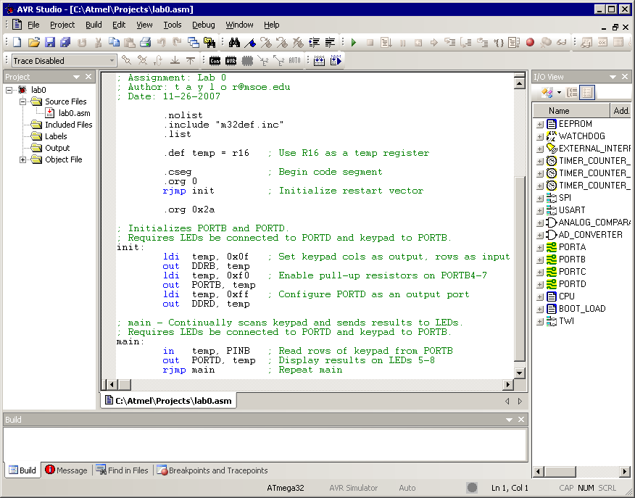
Assembly code (.a) example
Notes:
The C Preprocessor is not a part of the compiler, but is a separate step in the compilation process. In simple terms, a C Preprocessor is just a text substitution tool and it instructs the compiler to do required pre-processing before the actual compilation. We'll refer to the C Preprocessor as CPP.
All preprocessor commands begin with a hash symbol (#). It must be the first nonblank character, and for readability, a preprocessor directive should begin in the first column. The following section lists down all the important preprocessor directives −

Slide 13
Pre-processor
The preprocessor is also known as the pre-compiler.
The preprocessor is a text-substitution tool modifying the source code (*.c files) before compilation
Directives (e.g. #include) defines the actions to be performed by the pre-processor

Slide 14
Preprocessor – List of directives
Directives | Explanation | Example
#define | Substitute a preprocessor macro | #define PI 3.14
#include | Insert a particular header from another file | #include “Playlist.h”
#ifdef #endif | Return true if this macro is defined | #ifdef DEBUG /* your debug statement */ #endif
#ifndef #endif | Return true if this macro is not defined | #ifndef MESSAGE /* your message statement*/ #endif
#else | The alternative for #if
#elif | #else and #if in one statement
#error | Print error message on stderr
https://cplusplus.com/doc/tutorial/preprocessor/
Notes:
A macro is a fragment of code which has been given a name. Whenever the name is used, it is replaced by the contents of the macro

Slide 15
Compiler and linker
The compiler converts human-readable code (.c files) to computer-readable code a.k.a. object code (.o files)
The linker groups all objects files into an single executable file (.exe file)
In this course we use the gcc compiler (gcc.exe) to compile a program. Note: gcc is also used to call the linker and the pre-processor.

Slide 16
Makefile
Makefile
main.c
file1.h
file1.c
file2.h
file2.c
compiler
main.o
file1.o
file2.o
linker
main.exe
Target platform

Slide 17
Makefile
A makefile is file listing a group of actions required to build a program, i.e. to convert source code (.c files) into an executable (.exe). In other words, a makefile automates and facilitates the process of building a software program
A makefile is executed using the make program (make.exe).
Notes:
why

Slide 18
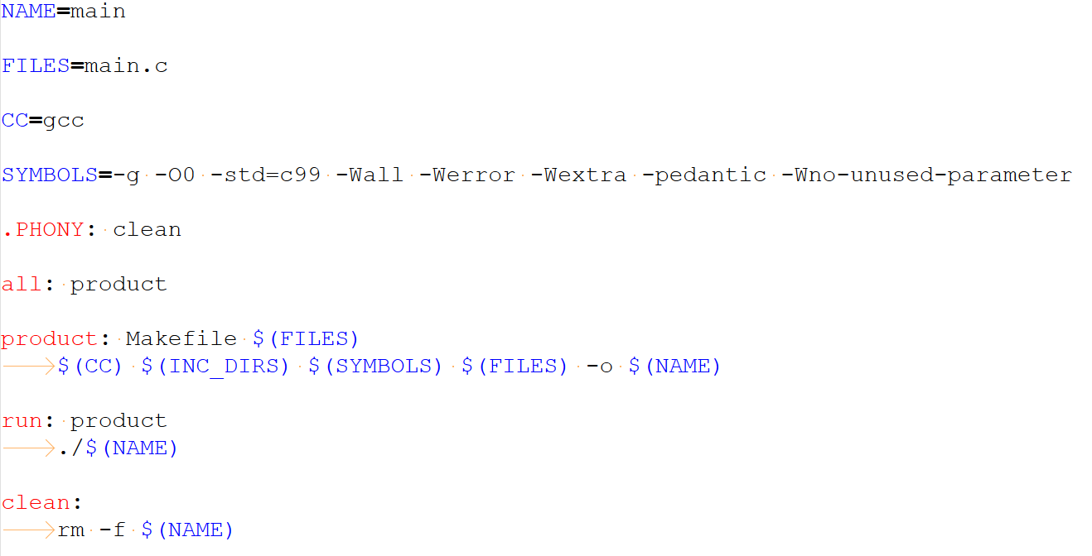
Example of makefile
Variables
Variables
Notes:
a.out

Slide 19
Exercise makefile
Inspect variable FILES
  What could be missing in order to be able to build the refactored version of the Warm-Up challenge?
Run target all using command: make all
  What do you notice? Was an executable generated?
Run target clean using command: make clean
  Inspect the files in your project folder. What do you notice? Are you still able to see an executable?
Run target run using command: make run
  What do you notice? What is the difference with make all
Notes:
a.out

Slide 20
References
Documentation of the C standard library (e.g printf, etc):
https://cplusplus.com/reference/
Makefile tutorial:
https://makefiletutorial.com/

