Slide 1
Programming in C

Slide 2
Week 1
Introduction

Slide 3
Introduction to course
Assessment
Assignments
Contact moments

Slide 4
Assessment
1 Learning Outcome: Procedural Embedded Programming (a.k.a PRC)
You are able design, develop, implement and test procedural-oriented software for a simple technical system

Slide 5
Assessment
The learning outcome is sub-divided into 4 criteria:
Criteria
Algorithm
Implementation
Testing
Maintainability
What do you think each criteria mean?
Can you give an example for each criteria?

Slide 6
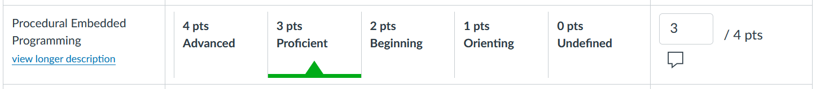
Assessment
What does longitudinal mean?
Assessment is longitudinal:
  It is YOUR responsability to timely submit your work in canvas
  It is YOUR responsability to pro-actively and regularly show your work, demonstrate your understanding and ask feedback and to your teacher.
  Your teacher will update the scale 4 times (weeks 6, 11, 15, 18)

Slide 7
Assignments
You are expected to submit at least 6 evidence of progress:
    Week 3/4  Deadline assignment 1
    Week 7/8  Deadline assignment 2
    Week 10/11  Deadline assignment 3
    Week 11  Live programming assignment
    Week 13/14  Deadline assignment 4 (part1)
    Week 15/16  Deadline assignment 4 (complete)

Slide 8
Assignments
Submitting is NOT sufficient. You should also take the initiave to show your work and ask feedback!
Example of deadlines:
 | Before Friday Week3 5PM / 17h | Before Friday Week4 5PM / 17h | After sFriday Week4 5PM / 17h
Canvas | ‘Due’ date (assignment is due) | ‘Until’ date (assignment closes) | Assignment is closed
What does it mean? | Student submits | Submission possible (1-week buffer accounting for unforeseen delays) Submission tagged LATE in canvas | Submissions are NOT possible. Corresponding assignment NOT assessed Submission tagged MISSING in canvas

Slide 9
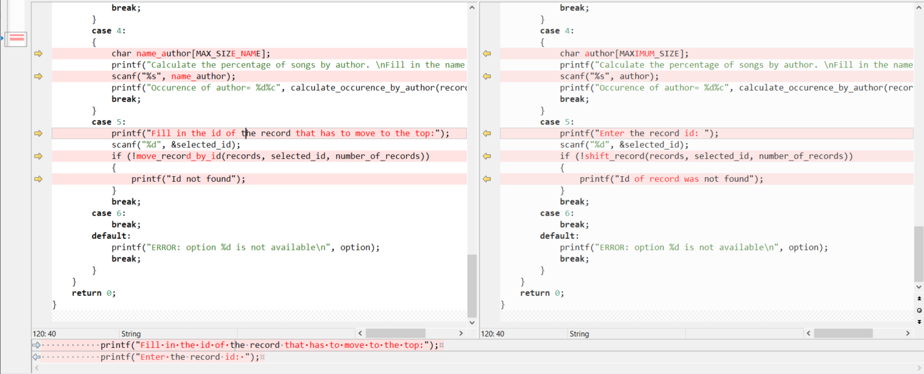
Assignments
See below the submissions of 2 students. What do you notice?
Student A
Student B

Slide 10
Assignments
Plagiarism is NOT accepted!
  Your are expected submit your own work/code
  You are encouraged to discuss concepts with your classmates. However, sharing code of assignments with your classmates is strongly discouraged as it may prevent you to successfully demonstrate the learning outcome
  You should be able to explain your code
What do you think about using AI tools such as ChatGPT, codepilot, etc?

Slide 11
Contact moments
Two contact moments per week, mostly following this structure
    Workshop:
      First contact moment in the week
      Teacher-driven: Teacher drives e.g. explanations, demos, exercises
    Practical
      Second contact moment in the week
      Student-driven: Student initiates contact with teacher for e.g. support, feedback
Your teacher may deviate from this structure above depending e.g. on student’s needs, requests, progress, etc

Slide 12
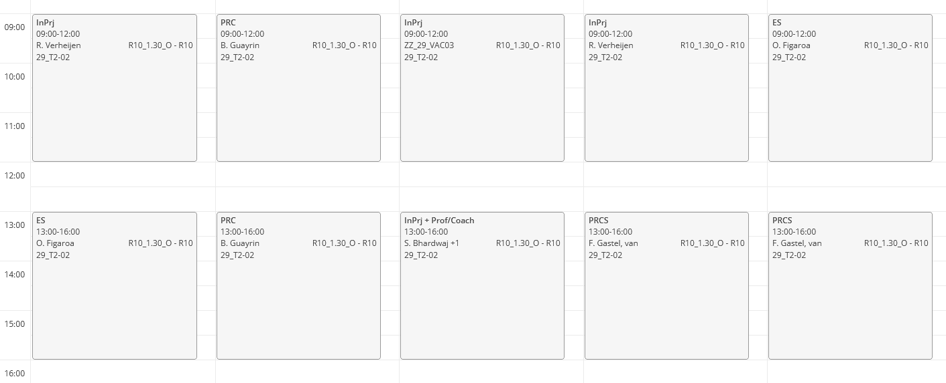
Contact moments : example of T2-02

Slide 13
Introduction to C
History of C
Applications of C
Set up the environment
Practice with environment
Recap Arrays

Slide 14
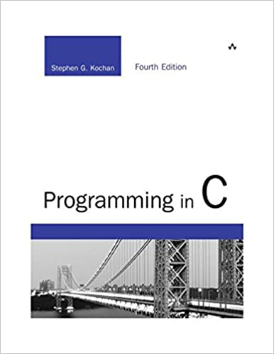
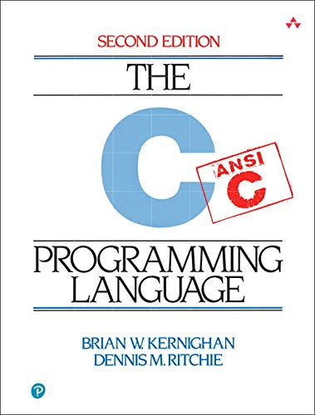
History of C
1972 C (Ritchie & Kerninghan)
1983 C++
1995 Java
2000 C#

Slide 15
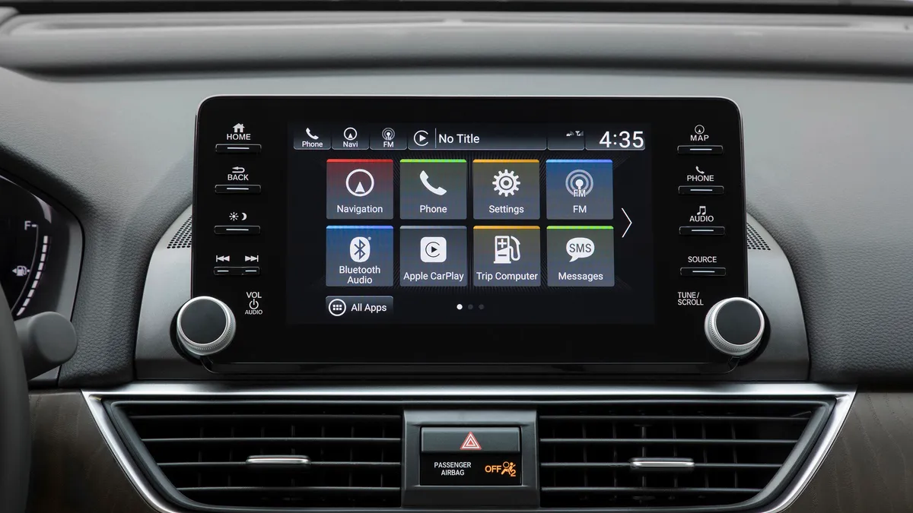


Applications of C
Embedded systems (small memory, fast to execute)
Operating systems
Compilers
Console applications
In PRC, we will (further) learn C in the context of console applications

Slide 16
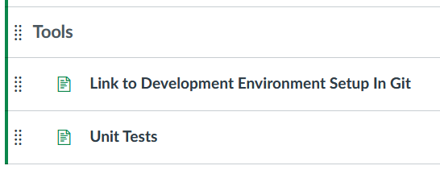


Setting up the environment
Build environment
We (strongly) recommend Windows users to utilise WSL: Windows Subsystem for Linux
Code editor
You may use your favorite code editor. You may think e.g. of Notepad++, MS Visual Code, etc
Recommendations and installation guidelines

Slide 17
What now?
Complete installation of your linux-based development environment
Done? Try to build and execute e.g. the startingProject
The startingProject can be found in the git repository.
You are NOT yet expected to complete the function swap: you should be able to do so after the lesson about pointers
Done? See exercises next slide to practice with your new development environment

Slide 18
Exercises
Notes:
  You are not expected to create functions for the exercises below. So all code can be placed in function main
  You may (re-)use the startingProject of the gitRepository
  To write values to the terminal you will need to use the library function printf. See tips next slide
  Knowledge of arrays is expected from semester1. You may recap the use of arrays using next slides
Exercise 1:
Declare an integer array of e.g. size 10. Initialize each element of the array with a value. Calculate the average value of the array. Write the average value to the terminal.
Exercise 2:
Find the maximum value of the above array. Write the maximum value to the terminal.
Exercise 3:
Adapt your code of exercise 2 to find the minimum value instead of the maximum value. What needs to be changed in your code (when compared to exercise 3)?
Notes:
Convert to descending order: 1. create a new array, reverse assigning the value, copy back
2. create a temp value, compare each a[i] with a[j], and swap the value

Slide 19
Support for exercises
Input and output: scanf and printf
Recap Arrays

Slide 20
Input and output: scanf and printf
The library cstring provides functions to to perform input & output operations. See full list of provided functions at:
https://cplusplus.com/reference/cstdio/
Data Type | Format specifier
int | %d
char | %c
float | %f
double | %lf
short int | %hd
unsigned int | %u
long int | %ld
long long int | %lld
unsigned long int | %lu
unsigned long long int | %llu
signed char | %c
unsigned char | %c
long double | %lf
#include <stdio.h> // Needed to use library cstdio
int main()
{
int a;
float b;
printf("Enter integer and then a float: ");
// Taking multiple inputs
scanf("%d %f", &a, &b);
printf("You entered %d and %f", a, b);
return 0;
}

Slide 21
Recap Array - Declaration
Declaring an array consists in specifying its datatype, name and size.
// type arrayName[arraySize]
char message[5];
int score[5];
float temperature[24];
What is the size of array score? What is the dimension of array score?

Slide 22
Recap Array - Initialization
See below common techniques for initializing an array
  Declare and initialize in one statement, i.e. in one line:
  Element by element, i.e. initializing and declarating on different lines:
  Initialize first element and set remaining elements to 0:
int score[] = {8, 6, 7, 5, 9}; // specifying array size is optional
int score[5]; // specifying size is mandatory
score[0] = 8;
score[1] = 6;
score[2] = 7;
int score[5] = {8};

Slide 23
Recap Array – Accessing elements
See below examples of accessing array elements
// Array scores consists of 3 integers
int scores[3] = {8,9,7};
// Access second value/element of array scores
int physics_score = score[1];

Slide 24
Recap Arrays – Demo
See also demo in git repository:
/Workshops/Week1/demoArrays.zip

