Slide 1
Programming in C

Slide 2
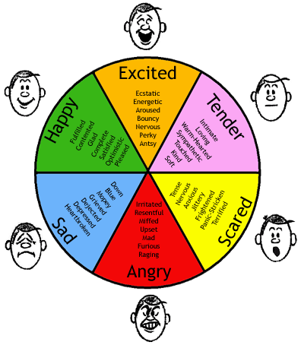
How do you feel after the Live Test?

Slide 3
Week 12
File Handling

Slide 4
File types
 | Text files | Binary files
(Short) desription | Consist of human-readable characters | Made up of non-human readable characters
Examples | .txt .csv .json | .exe .mp4 .png
Editor | Any text editor such as notepad | Specific editor such as VLC for videos

Slide 5
File operations
Three steps are required to handle files.
The standard library cstdio provides all needed functions to open, read, write and close a file. Be investigative and refer to the full list of built-in functions e.g. at:
https://cplusplus.com/reference/cstdio/
Open
file
Process file
(read or write)
Close
file

Slide 6
File opening
FILE * fopen(const char * filename, const char * mode);
Parameters:
- filename: string literal to hold the name of the file
- mode: read or write mode when open the file
Return value:
- A pointer to a FILE structure

Slide 7
File opening
Several opening modes are supported. See exhaustive list of modes at:
https://cplusplus.com/reference/cstdio/fopen/
Mode | Description
r | Opens an existing text file for reading purpose
w | Creates a new text file for writing purpose
rb | Opens a binary file for reading purpose
wb | Creates a new binary file for writing purpose
… | …

Slide 8
File closing
int fclose(FILE * stream);
Parameters:
- stream: pointer to a FILE structure
Return value:
- integer indicating whether the file is successfully closed

Slide 9
Code example of opening and closing a file
#include <stdio.h> // Needed for handling files
#include <stdlib.h> // Needed for exit() function
int main() {
FILE* inputFile;
inputFile = fopen("input.txt","r");
if (inputFile == NULL) {
printf("Error: file cannot be opened");
exit(EXIT_FAILURE); // Program is terminated
}
fclose(inputFile);
return (0);
}
What do you think the exit function does?
What is the difference between using exit and return?

Slide 10
Reading data from a file
The library cstdio provides 4 functions to read data from a file
Function | fgetc | fgets | fread | fscanf
Intented use | Read a file byte per byte | Read a file line by line | Read a customized amount of byte from a file | Read formatted data from a file

Slide 11
Example of reading characters using fgetc
int main() {
// OPEN FILE
FILE* inputFile = fopen("input.txt", "r");
if (inputFile == NULL) {
exit(EXIT_FAILURE);
}
// PROCESS FILE
char c;
while( (c = fgetc(inputFile)) != EOF ) {
printf("%c", c);
}
// CLOSE FILE
fclose(inputFile);
return (0);
}
What do you think EOF means?
See also demoReadFile.zip
What do you think this program does?

Slide 12
Exercise 1
Opens an existing input file (see story.txt in canvas). The file contains typos that will be fixed in exercise 3 by means of bit manipulation
Print the content of the file to the terminal. You may think of using the example from previous slide
Extend the program to count the number of line breaks and print the result to the terminal?
Do not forget to close any file(s) that have been opened!

Slide 13
Write data to a file
The library cstdio provides 4 functions to write data to a file
Function | fputc | fputs | fwrite | fprintf
Intented use | Write data to a file byte per byte | Write data to a file line by line | Write a customized amount of byte to a file | Write formatted data to a file
See demo of fputc in demoWriteFile.zip

Slide 14
Use of command line arguments
Hard-coding name of files
Passing file name from command prompt
int main()
{
// OPEN FILE
FILE* inputFile = fopen("input.txt", "r");
if (inputFile == NULL) {
exit(EXIT_FAILURE);
}
// PROCESS AND CLOSE FILE
// …
return (0);
}
int main(int argc, char const *argv[])
{
// OPEN FILE
FILE* inputFile = fopen(argv[1], "r");
if (inputFile == NULL) {
exit(EXIT_FAILURE);
}
// PROCESS AND CLOSE FILE
// …
return (0);
}
What do argc and argv mean?

Slide 15
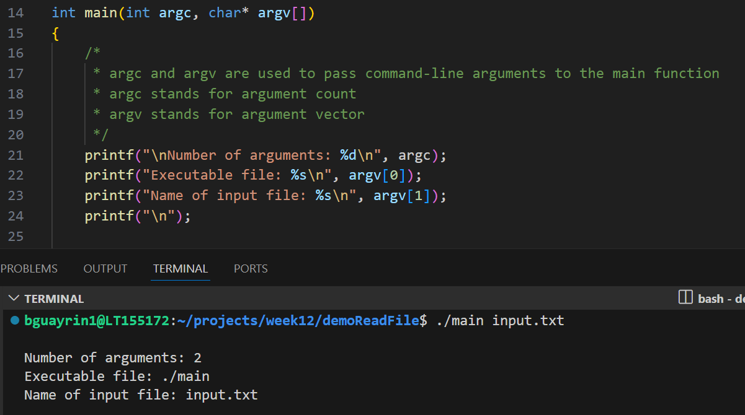
Use of command line arguments
Filename passed as argument

Slide 16
Exercise 2
Opens an existing input file (see story.txt in canvas)
Create a program to write the uppercase version of the input file into a new output file (e.g. output.txt). Tip: you can use the function toupper from the c standard library (https://cplusplus.com/reference/clibrary/)
    Lower case example: hello
    Upper case example: HELLO
Make sure to be able to execute the program from the terminal. You can for instance use the command:
./main story.txt output.txt
Do not forget to close any file(s) that have been opened!

Slide 17
Exercise 3
Open an existing input file (see story.txt in canvas). As you may have noticed, the input file contains several typos.
Create a program to fix the typos of the input file and write the result in an output file. For every input byte use the following bitwise logic to fix the typos. Remember that a byte consists of 8 bits: b7 b6 b5 b4 b3 b2 b1 b0
Bit-wise logic: IF b6 in your byte equals 0 AND both b2 and b3 equal 1 THEN invert b1
Make sure to be able to execute the program from the terminal. You can for instance use the command:
./main story.txt output.txt
Do not forget to close any file(s) that have been opened!
Compare the input and output files. What difference(s) do you notice?

